Slide 1


Real World Use Case
Now let us take a look at a real world use case.
Introduction

Slide 2


A real world use case
Lets have 2 teams, Team A and Team B
Both teams share the same infrastructure (hardware) in the company. In the past they had requirements which allowed them to run JDK 1.7 and Tomcat 7 so they were able to expose different ports and get their applications running in production using the same infrastructure.
SO they have NO issues.
Introduction

Slide 3
Real World Use Case
Team A
Has engineers who develop on MAC OSX, however their application in production is going to run on UBUNTU 16.01 with JDK 1.7 and Tomcat 7 and QA doesn’t like the idea of shipping software developed on MAC OSX and QA-ed on Ubuntu.
Team B
Wants to upgrade JDK to 1.8 and Tomcat 8 and wants to run CENTOS in production to run their app
Now the Problem
Introduction

Slide 4

Real World Use Case
Problem Summary
Developing on different operating systems and having QA test it.
How can we have the same hardware server support 2 version of JDK , one on 1.7 and the other on 1.8
How can the server which costs several thousand dollars be used optimally to cater to both teams?
Introduction

Slide 5
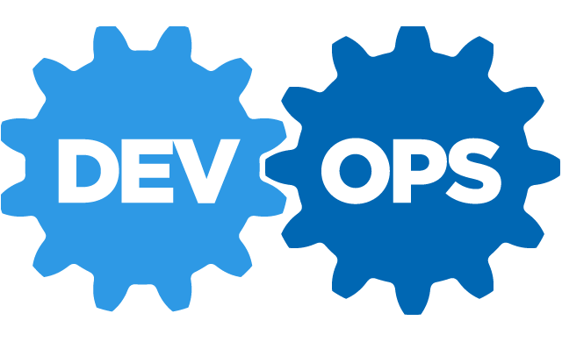
Who is worried about what?
The problem continues…..
DEVOPS is worried about
Frequent change in JDK versions and software requirements for both the teams.
Operationalizing both the applications in the same infrastructure.
Making sure QA team gets the application with the same set up where it was developed
Introduction

Slide 6


Who is worried about what?
Developers and QA
Developers are worried about how they would develop in different operating systems, integrate their changes and have QA test it.
QA is concerned about whether it is valid to even test a piece of software developed with different versions of hardware and operating systems in the test environment where the OS and hardware does not match what the product was developed on.
The problem continues…..
Introduction

Slide 7

Who is worried about what?
So both teams talk to the manager to get new hardware as a means to solve the issue !!! ☺
The management declines the proposal states the following
No budget for new hardware
Use existing hardware and optimize
But still guarantee all applications developed can work independently on the same software and can be developed on the same platforms and tested
Introduction

Slide 8

How do we solve all of this?
Introduction

